Slide 1
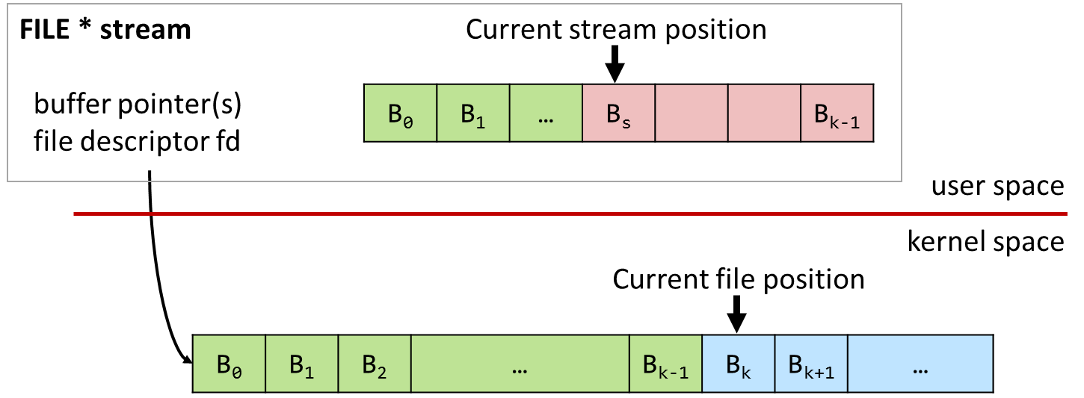
Input/Output Direct and Buffered I/O

Slide 2
Lecture Outline
Unix I/O
Standard I/O
Interaction of Standard I/O with Unix I/O
Summary

Slide 3
Unix I/O
int fd = open(“unix.io”,
O_CREAT | O_WRONLY,
S_IRWXU | S_IRGRP);

Slide 4
Unix I/O: Overview
Unix I/O refers to the interface of *nix kernels to perform input/output
lowest level of I/O an application programmer can perform
Unix I/O is implemented with system calls
Design concept: one standardized, general interface to access files of any type
regular files, directories
block devices: disks, partitions, …
character devices: memory, keyboards, mice, …
pipes, sockets, …
all input and output is handled in a consistent and uniform way!
One single file interface to interact with any kind of device
(well, almost)

Slide 5
Unix I/O: File Abstraction
An open file is identified by a file descriptor (handle)
uniquely identifies the underlying file in a process
Handle required for methods to update the state of a file
Returned when opening/creating a file, used in all subsequent file operations
Each open file has an internal pointer pointing to the current position in the file
read/write operations start from that position and advance it
subtleties arise when sharing file descriptors
File descriptor fd
Current file position = k
B₀ | B₁ | B₂ | … | B_{k-1} | B_{k} | B_{k+1} | …

Slide 6
Unix I/O: File Descriptors
File descriptors are non-negative integers uniquely identifying open files of a process
Per-process: fd 10 on process 1 and fd 10 process 2 refer to different files
Each process begins life with three open file descriptors (defined in unistd.h)
0: STDIN_FILENO standard input
1: STDOUT_FILENO standard output
2: STDERR_FILENO standard error
by default, these file descriptors are connected to the terminal and used for input, output, and error output
Any other file descriptor must be obtained using the Unix I/O API

Slide 7
Unix I/O API
System calls offered by the kernel
Convenient wrappers provided by the C standard library (fcntl.h/unistd.h)
Operation | API | Variants
Open and create | int open(const char *pathname, int flags) int creat() | openat
Read and write | ssize_t read(int fd, void *buf, size_t count) ssize_t write(int fd, void *buf, size_t count) | pread, readv pwrite, writev
Positioning | off_t lseek(int fd, off_t offset, int whence) | llseek, lseek64
Close | int close(int fd)
Remove from filesystem | int remove(const char *pathname) | unlink, unlinkat, rmdir
Hint: finding the base type of an unknown type t $ echo "#include <stdlib.h>" | gcc -E - | grep -w _*t
e.g., $ echo "#include <stdlib.h>" | gcc -E - | grep -w _*off_t

Slide 8
Opening and Creating Files
Opening a file informs the kernel that you are getting ready to access that file
pathname: name (and path) to file
flags: status and creation flags such as O_RDONLY, O_APPEND, …
mode: file mode for newly created files such as S_IRWXU, S_IRGRP, …
refer to man page for details
Returns a file descriptor
-1 indicates that an error has occurred (errno #include <errno.h>)
#include <sys/types.h>
#include <sys/stat.h>
#include <fcntl.h>
int open(const char *pathname, int flags);
int open(const char *pathname, int flags, mode_t mode);
int creat(const char *pathname, mode_t mode);
How can open() take variable # of parameters? It is similar to printf().
$ echo "#include <fcntl.h>" | gcc -E - | grep "open"
extern int open (const char *__file, int __oflag, ...) __attribute__ ((__nonnull__ (1)));
extern int openat (int __fd, const char *__file, int __oflag, ...)

Slide 9
Opening and Creating Files
Opening a file informs the kernel that you are getting ready to access that file
int fd;
if ((fd = open("/etc/hosts", O_RDONLY)) < 0) {
perror("Cannot open file");
exit(EXIT_FAILURE);
}
int fd = creat(“log", S_IRUSR|S_IWUSR);
if (fd < 0) {
perror("Cannot create file");
exit(EXIT_FAILURE);
}

Slide 10
Closing Files
Closing a file informs the kernel that you are finished accessing that file
fd: (open) file descriptor
Returns 0 on success, -1 on error
Closing an already closed file is an error
may cause unexpected failures in multithreaded programs (why?)
A closes fd, B opens a file (=fd), C closes fd (already closed file) again
#include <unistd.h>
int close(int fd);

Slide 11
Closing Files
Closing a file informs the kernel that you are finished accessing that file
int fd;
int retval;
…
if ((retval = close(fd)) < 0) {
perror("Cannot close file");
exit(EXIT_FAILURE);
}

Slide 12
Reading and Writing Files
Reading/writing a file copies count bytes from the current file position to memory or vice-versa, and then updates the file position
fd: file descriptor
buf: buffer that holds data
count: number of bytes to read/write
Returns number of bytes read/written
Return value of < 0 indicates that an error occurred (see manpage)
Short counts, i.e., retval < sizeof(buf), are possible and not necessarily errors (more details later)
#include <unistd.h>
ssize_t read(int fd, void *buf, size_t count);
ssize_t write(int fd, const void *buf, size_t count);

Slide 13
Reading Files
Reading a file copies bytes from the current file position to memory, and then updates file position
char buf[512];
int fd;
ssize_t nbytes;
…
if ((nbytes = read(fd, buf, sizeof(buf))) < 0) {
perror("Cannot read from file");
exit(EXIT_FAILURE);
}

Slide 14
Writing Files
Writing a file copies bytes from memory to the current file position, and then updates current file position
char buf[512];
int fd;
ssize_t nbytes;
…
if ((nbytes = write(fd, buf, sizeof(buf)) < 0) {
perror("Cannot write to file");
exit(EXIT_FAILURE);
}

Slide 15
“Hello, world!” with Unix I/O
Write contents of buffer containing “Hello, world!” to STDOUT_FILENO
write() requires us to specify the number of bytes to write
use ‘strlen()’ from the string API (string.h) is correct here because the string ‘str’ includes a terminating \0 character at its end which is included in sizeof(str) but ignored by ‘strlen(str)’
in principle, we should always check the return value of write()
#include <stdlib.h> #include <unistd.h>
#include <string.h>
char str[] = "Hello, world\n";
int main(void)
{
write(STDOUT_FILENO, str, strlen(str));
return EXIT_SUCCESS;
}
unixio/helloworld.c

Slide 16
“Hello, world!” with Unix I/O
Write contents of buffer containing “Hello, world!” into a file
While STDOUT_FILENO is already open & available to be written to, we have to open (create) the output file explicitly here
#include <stdlib.h>
#include <unistd.h>
#include <string.h>
#include <fcntl.h>
#include <stdio.h>
char str[] = "Hello, world!\n";
int main(void) {
int fd = open("./output.txt", O_WRONLY | O_CREAT | O_APPEND, S_IRUSR|S_IWUSR | S_IRGRP | S_IROTH);
if (fd == -1) {
perror("Cannot open/create file");
return EXIT_FAILURE;
}
write(fd, str, strlen(str));
close(fd);
return EXIT_SUCCESS;
}
unixio/helloworld2file.c

Slide 17
Seeking in Files
Change the file position
fd: file descriptor
offset: offset in relation to whence
whence: base
SEEK_SET: filepos = offset
SEEK_CUR: filepos = filepos + offset
SEEK_END: filepos = end + offset (can seek beyond end of file)
Returns new absolute position or -1 to indicate that an error has occurred
A “hole” (a sequence of zeros) can exist in a file depending on the file system
e.g., lseek() to a location beyond the size followed by write()
#include <sys/types.h>
#include <unistd.h>
off_t lseek(int fd, off_t offset, int whence);

Slide 18
Seeking in Files
Change the file position
int fd;
…
if (lseek(fd, 100, SEEK_SET) < 0) {
perror("Cannot seek in file");
exit(EXIT_FAILURE);
}

Slide 19
Simple Unix I/O example
Copying stdin (standard in) to stdout (standard out), one byte at a time
#include <stdlib.h>
#include <unistd.h>
int main(void)
{
char c;
while (read(STDIN_FILENO, &c, 1) > 0) {
write(STDOUT_FILENO, &c, 1);
}
return EXIT_SUCCESS;
}

Slide 20
Short Counts
A short count is a situation when Unix I/O reads/writes fewer bytes than requested, but does not report an error (-1).
Short counts can occur in many situations:
Encountering EOF (end-of-file) on reads
Filesystem full on write
Reading text lines from a terminal
Reading and writing network sockets or Unix pipes
Interrupts and signals sent to the process
Dealing with short counts requires careful inspection of the return value and errno
see manpage for read
ssize_t nbytes = read(fd, buf, 512);
printf("Read %ld bytes.\n", nbytes);
Read 302 bytes.
RETURN VALUE
… It is not an error if this number is smaller than the number of bytes requested; this may happen for example because fewer bytes are actually available right now (maybe because we were close to end-of-file, or because we are reading from a pipe, or from a terminal), or because read() was interrupted by a signal.

Slide 21
Full Unix I/O Example: Copying Data
“unixio” appends n bytes from offset ofs in file input to file output
(actual code is not shown here)
Take arguments from command line
Create output file if necessary
Check for errors, in particular, short counts
$ ./unixio data.dat test.dat 400000 100000
Opening input file 'data.dat'...
Opening output file 'test.dat'...
Seeking input file to position 400000...
Copying 100000 bytes...
Short count of 27776 when trying to read 34464 bytes from input
copied a total of 93312 bytes.
Closing files...

Slide 22
Standard I/O
FILE *f = fopen("standard.io",
"r+");

Slide 23
Shortcomings of Unix I/O
Applications often read/write character data
read/write one character at a time
read/write one line of text at a time
Unix I/O
calls are mapped 1:1 to system calls
mode switch is expensive: 1,00~10,000 clock cycles (syscall, TLB/cache miss effect, etc.)
not well suited for string handling
Copying 10 MiB byte-by-byte: Unix I/O vs Standard I/O
$ time ./copy_unixio …
real 0m2.679s
user 0m0.363s
sys 0m2.316s
$ time ./copy_stdio …
real 0m0.261s
user 0m0.261s
sys 0m0.000s

Slide 24
Standard I/O
Goals
reduce overhead of I/O
provide formatted I/O

Slide 25
Standard I/O
Achieving the first goal: use a buffer to reduce number of read() and write() system calls
Buffering is (mostly) transparent to the user
Three types of buffering: fully buffered, line buffered, and unbuffered
Achieving the second goal: provide a formatted I/O library (fprintf/fscanf family)
Operates on top of Standard I/O streams
Independent of buffering mode

Slide 26
Unix I/O vs Standard I/O
Standard I/O: buffered read
Use Unix read to grab block of bytes
User input functions take one byte at a time from buffer
Refill buffer when empty
FILE * stream
buffer pointer(s)
file descriptor fd
Current stream position
B₀ | B₁ | … | B_{s} |  |  | B_{k-1}
user space
kernel space
Current file position
B₀ | B₁ | B₂ | … | B_{k-1} | B_{k} | B_{k+1} | …

Slide 27
Standard I/O API
Collection of higher-level standard I/O functions implemented in C standard library (header stdio.h)
Operation | API | Variants
Open and create | FILE *fopen(const char *path, const char *mode) | fdopen, freopen
Read and write | size_t fread(void *ptr, size_t size, size_t nmemb, FILE *stream) size_t fwrite(const void *ptr, size_t size, size_t nmemb, FILE *stream)
Positioning | int fseek(FILE *stream, long offset, int whence) long ftell(FILE *stream) | rewind, fsetpos fgetpos
Close | int fclose(FILE *stream) | fcloseall
Others | int fflush(FILE *stream) int feof(FILE *stream) int ferror(FILE *stream) int fileno(FILE *stream)

Slide 28
Standard I/O API
Standard I/O also includes well-known functions for formatted input/output
Operation | API | Variants
Read character or line | char *fgets(char *s, int size, FILE *stream) | gets, fgetc, getc, getchar, ungetch
Read formatted input | int fscanf(FILE *stream, const char *format, …) | scanf, sscanf, vscanf, …
Write character or line | char fputs(const char *s, FILE *stream) | fputc, putc, putchar, puts
Write formatted output | int fprintf(FILE *stream, const char *format, …) | printf, dprintf, sprint, snprintf, vprintf, …

Slide 29
Standard I/O Streams
The default Unix I/O STD*_FILENO file descriptors are mapped to corresponding I/O streams (defined in stdio.h)
stdin stream for STDIN_FILENO standard input
stdout stream for STDOUT_FILENO standard output
stderr stream for STDERR_FILENO standard error
#include <stdio.h>
#include <stdlib.h>
extern FILE *stdin; // standard input (file desc: STDIN_FILENO)
extern FILE *stdout; // standard output (file desc: STDOUT_FILENO)
extern FILE *stderr; // standard error (file desc: STDERR_FILENO)
int main(void)
{
fprintf(stdout, "Hello, world\n");
return EXIT_SUCCESS;
}

Slide 30
“Hello, world!” with Standard I/O
Write contents of buffer containing “Hello, world!” to stdout
[f]printf() supports formatted output and calculates the length of the string for you
#include <stdio.h>
#include <stdlib.h>
char str[] = "Hello, world!\n";
int main(void)
{
fprintf(stdout, "%s", str); // specify output stream
printf("%s", str); // implicitly print to stdout
return EXIT_SUCCESS;
}
stdio/helloworld.c

Slide 31
“Hello, world!” with Standard I/O
Write contents of buffer containing “Hello, world!” into a file
Also with Standard I/O, we have to explicitly open/close files
#include <stdio.h>
#include <stdlib.h>
char str[] = "Hello, world!\n";
int main(void) {
FILE *out = fopen("./output.txt", "a+"); // a+: reading and appending
if (out == NULL) {
perror("Cannot open/create file");
return EXIT_FAILURE;
}
fprintf(out, “%s”, str);
fclose(out);
return EXIT_SUCCESS;
}
stdio/helloworld2file.c

Slide 32
Understanding Buffering in Standard I/O
To flush, or not to flush, that is the question
Buffer flushed to output fd on "\n" or fflush() call
on "\n" only when output is a terminal (see following slides)!
printf("h");
printf("e");
printf("l");
printf("l");
printf("o");
buf
printf("\n");
h
e
l
l
o
\n
.
.
fflush(stdout);
write(1, buf, 6);

Slide 33
Standard I/O Buffering Types
Buffering is (mostly) transparent to the user, but depends on the underlying file type
Standard I/O supports three types of buffering Type Mode Default for
Fully buffered _IOFBF file descriptor points to a file
Line buffered _IOLBF file descriptor connected to a terminal (stdout)
Unbuffered _IONBF standard error or by user request (stderr)
Standard I/O buffer size (BUFSIZ) is 8KB on modern systems (glibc v. 2.35)
Manually set with setvbuf() – type as well as the buffer

Slide 34
Standard I/O: Fully buffered
For files
Unix I/O occurs when
fread(): buffer is empty and needs to be filled
fwrite(): buffer is full and needs to be emptied
Flushing (writing the buffer to disk) occurs
Automatically when the buffer is full
Manually when calling fflush()

Slide 35
Standard I/O: Line Buffered
Typically used for terminal devices
Unix I/O occurs
when a newline character is encountered in output
when the buffer is full
when input operation is requested
when fflush() is called
when the stream is closed
When the process terminates
Caveats
When buffer is full, it is flushed even if there is no newline
Lots of head scratching when mixing input and output operations

Slide 36
Standard I/O: Unbuffered
Uses no buffering
Standard I/O FILE interface for Unix I/O
By default, the standard error stream is unbuffered
All output is written immediately to the terminal

Slide 37
Standard I/O Buffering in Action
Observe buffering in action using the always fascinating Unix strace program:
#include <stdio.h>
#include <stdlib.h>
int main()
{
setvbuf(stdout, NULL, _IOLBF, 0);
printf("hello\n");
printf(“hello");
printf(“,");
fflush(stdout);
printf(“wor");
printf(“ld");
printf("\n");
return EXIT_SUCCESS;
}
$ strace –o log ./bufferedio x
…
$ cat log
execve("./bufferedio", ["bufferedio", "x"], …)
…
write(1, "hello\n", 6) = 6
…
write(1, "hello,", 6) = 6 … write(1, "world\n", 6) = 6
exit_group(0) = ?

Slide 38
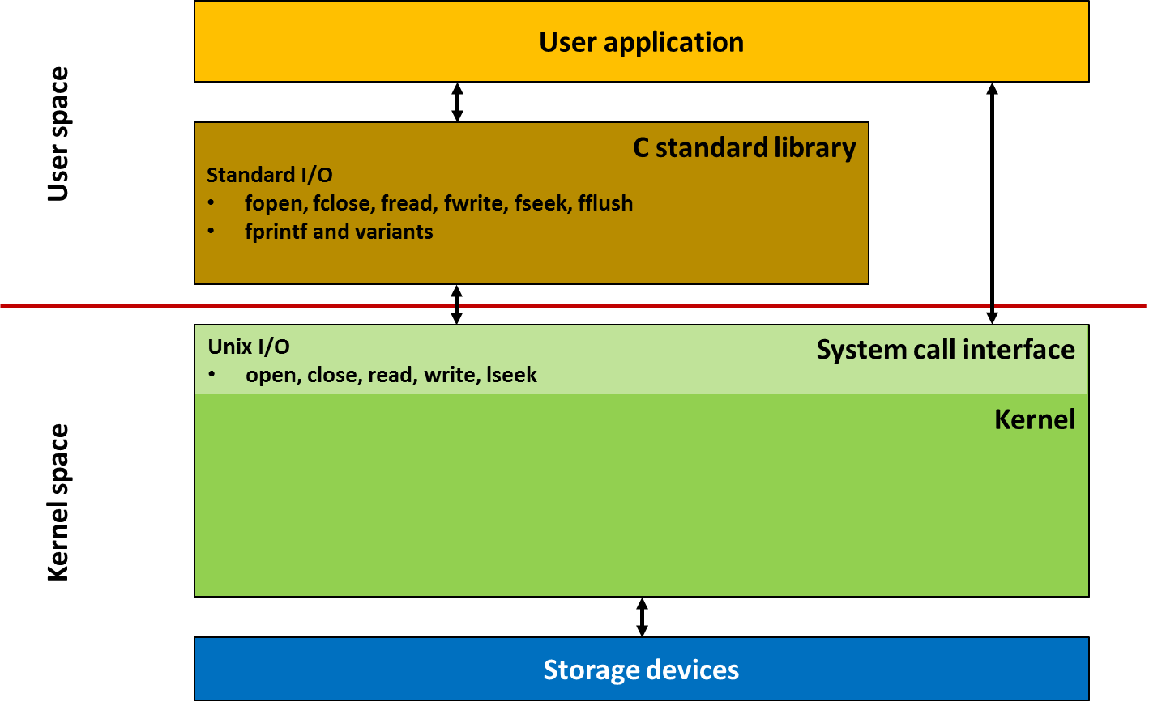
Interaction of Standard I/O with Unix I/O

Slide 39
Standard I/O and Unix I/O
User application
Standard I/O
fopen, fclose, fread, fwrite, fseek, fflush
fprintf and variants
User space
C standard library
Unix I/O
open, close, read, write, lseek
System call interface
Kernel
Kernel space
Storage devices

Slide 40
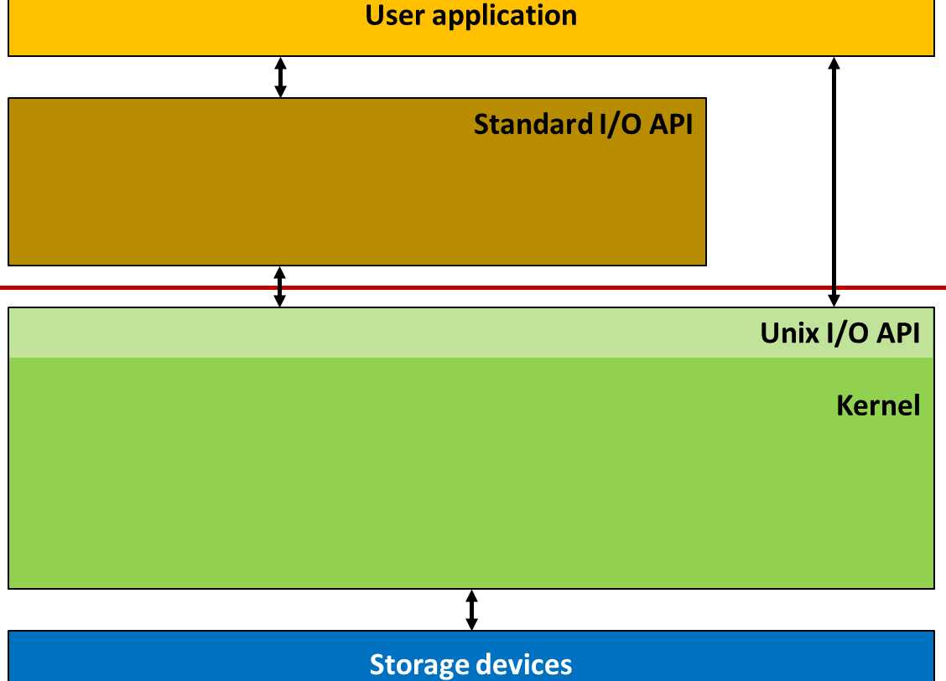
Standard I/O and Unix I/O
FILE *f = fopen("input.txt", "r");
fread(…);
Process A
ssize_t bufpos = 378
void *buf
int fd = 4
abc … lmn
opq … xyz
file descriptor
table of process A
input.txt
fd 4
File access
pos = 1024
File size
refcnt=1
File type
...
...
disk block cache
0
1024
n
input.txt
abc…mnop…xyz
012…789

Slide 41
Standard I/O and Unix I/O
Pseudo code
#define BUFSIZE 8192 FILE* fopen(char *path, char* mode) { int fd = open(path, …); if (fd == -1) return NULL; FILE *stream = malloc(sizeof(FILE)); stream->fd = fd; stream->buffer = malloc(BUFSIZE); stream->bufpos = 0;
stream->is_empty = 1; return stream; }

Slide 42
Standard I/O and Unix I/O
Pseudo code (assumes read() always reads BUFSIZE bytes) void refill_buffer(FILE *stream) { read(stream->fd, stream->buffer, BUFSIZE); stream->bufpos = 0; stream->is_empty = 0; } int fclose(FILE *stream) { close(stream->fd); free(stream->buffer); return 0; } int fileno(FILE *stream) { return stream->fd; }

Slide 43
Standard I/O and Unix I/O
Pseudo code (assumes refill_buffer() always refills the buffer) size_t fread(void *ptr, size_t size, size_t nmemb, FILE *stream) { size_t total_bytes = size*nmemb; size_t read_bytes = 0;
if (stream->is_empty) refill_buffer(stream);
while (read_bytes < total_bytes) { int copy_bytes = min(total_bytes-read_bytes, BUFSIZE-stream->bufpos); memcpy(ptr+read_bytes,
stream->buf+stream->bufpos, copy_bytes); read_bytes += copy_bytes; stream->bufpos += copy_bytes; if (stream->bufpos == BUFSIZE) refill_buffer(stream); } return read_bytes; }

Slide 44
Class Summary
Summary
-------------
-------------
-------------
-------------
-------------
-----

Slide 45
Summary: Unix I/O
Pros
Unix I/O is the most general and lowest overhead form of I/O.
All other I/O packages are implemented using Unix I/O functions.
Unix I/O provides functions for accessing file metadata (stat(), fstat(), etc.).
Unix I/O functions are async-signal-safe and can be used safely in signal handlers.
Cons
Dealing with short counts is tricky and error prone.
Efficient reading of text lines requires some form of buffering, also tricky and error prone.
Both of these issues are addressed by the standard I/O packages.

Slide 46
Summary: Standard I/O
Pros
Buffering increases efficiency by decreasing the number of read and write system calls in a “typical” setting (e.g., text processing like decomment)
This does not mean Standard I/O is fundamentally more efficient.
Short counts are handled automatically
Cons
Provides no function for accessing file metadata
Standard I/O functions are not async-signal-safe, and not appropriate for signal handlers.
Standard I/O is not appropriate for input and output on network sockets
There are poorly documented restrictions on streams that interact badly with restrictions on sockets (CS:APP3e, Sec 10.9)

Slide 47
Choosing I/O Functions
General rule: use the highest-level I/O functions you can
Many C programmers are able to do all of their work using the standard I/O functions
When to use standard I/O
When working with disk or terminal files
When to use raw Unix I/O
Inside signal handlers, because Unix I/O is async-signal-safe.
In rare cases when you need absolute highest performance.
Standard I/O provides reasonable efficiency for most applications, but if you need the highest performance fine-tuned for your application, use Unix I/O

